Slide 1
HOSPITALITY ANALYSIS PRESENTATION Tools: Excel, Power Bi, Tableau, SQL

Slide 2
INTRODUCTION
This project analyzes the Hospitality Analysis dataset to evaluate revenue performance, customer behavior, Booking patterns and occupancy rates. The objective is to convert raw business data into meaningful insights using data analysis and visualization techniques.
Using tools like EXCEL, SQL, POWER BI, and TABLEAU, the data was cleaned, transformed, and visualized to create an interactive dashboard.
The insights generated from this analysis support data-driven decision making, help identify growth opportunities, and improve overall business performance through interactive reports and dashboards.

Slide 3
DATA PREPARATION
Data Preparation Process (Excel, SQL, Power BI, Tableau)
Excel: Removed duplicate rows and blank values
Corrected data formats and standardized column names
Power BI: Connected to SQL database using Power Query
Transformed data and created DAX measures
Built interactive KPI cards and charts
Tableau: Connected directly to SQL database
Created calculated fields and filters
Designed visual dashboards for trend and performance analysis
SQL: Loaded cleaned Excel data into SQL tables
Applied filters, joins, and aggregations using SQL queries
Created calculated fields for KPIs such as rejection rate and efficiency

Slide 4
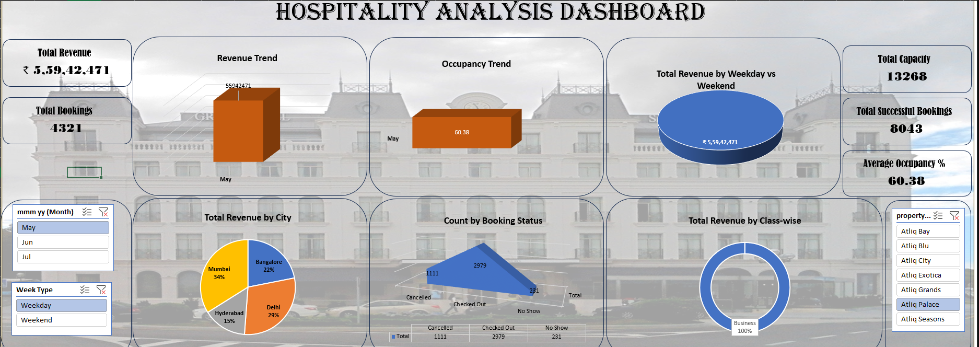
EXCEL DASHBOARD

Slide 5
OVERALL ANALYSIS OF EXCEL DASHBOARD
The Excel analysis reveals clear patterns in occupancy, revenue, and customer behavior across the evaluated period.
Customer satisfaction metrics show a strong link between service efficiency and repeat bookings.
Data-driven decision making can significantly enhance operational efficiency and profitability.
Overall Insight: Excel analytics enables hospitality businesses to identify trends, control costs, improve guest experience, and support strategic planning for sustainable growth.
Peak performance is driven by seasonal demand, pricing strategy, and service quality indicators.

Slide 6
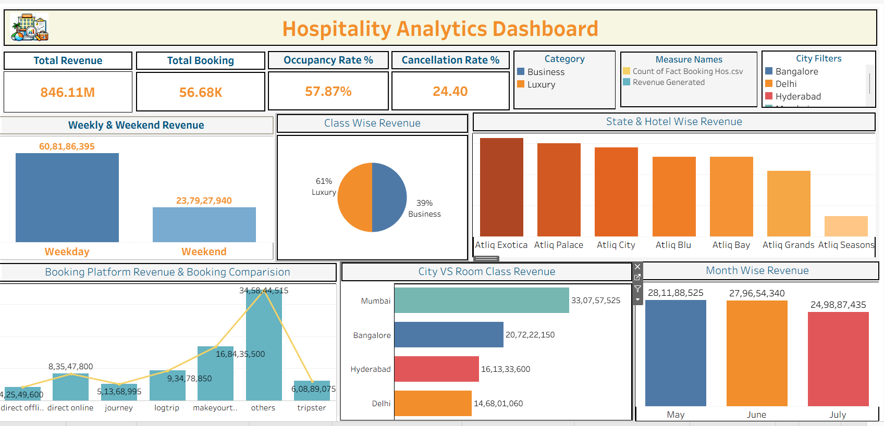
TABLEAU DASHBOARD

Slide 7
OVERALL ANALYSIS OF TABLEAU DASHBOARD
Tableau enables interactive and visual analysis of Key Performance Indicators (KPIs), helping stakeholders quickly understand business performance and trends. KPI dashboards in Tableau combine multiple metrics into a single, intuitive view that supports data-driven decision-making.
The Tableau KPI dashboard transforms raw data into actionable insights by providing real-time visibility into business performance. Its interactive and visual approach enables organizations to monitor goals, identify risks, and optimize strategies effectively.

Slide 8
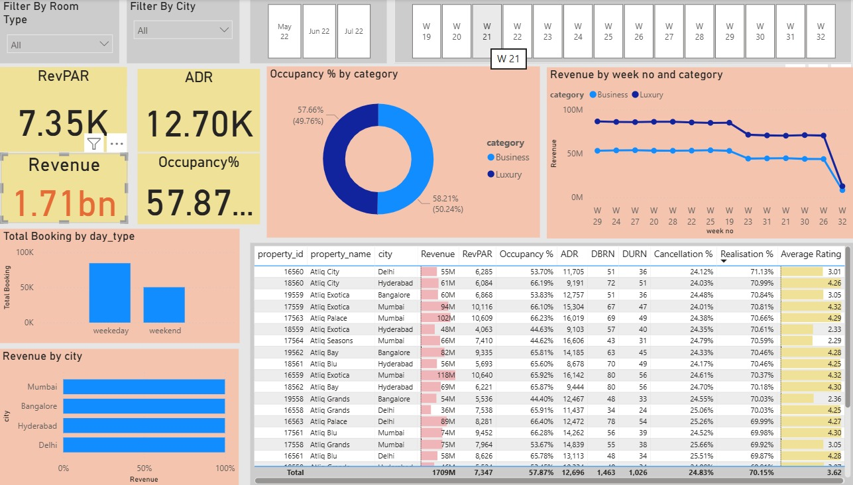
POWER BI DASHBOARD

Slide 9
OBVERALL ANALYSIS OF POWER BI DASHBOARD
The Power BI dashboard provides a unified, real-time view of hospitality performance across occupancy, revenue, and customer behavior. Revenue performance is strongly influenced by pricing strategy and room type mix. Customer insights show that service quality and booking channel significantly impact satisfaction and repeat visits.
Operational efficiency opportunities exist in low-occupancy periods through targeted promotions and dynamic pricing. Data-driven decision making enables improved forecasting, optimized resource allocation, and higher profitability.

Slide 10
SQL
The SQL-based hospitality analysis reveals clear performance patterns across occupancy, revenue, and guest behavior. Peak revenue periods align strongly with high occupancy and premium room categories, while mid-week demand shows untapped capacity that can be improved through targeted pricing and promotions. Customer segmentation highlights repeat guests as a major revenue driver, emphasizing the importance of loyalty programs and personalized offers. Operationally, data indicates that optimized staffing levels and dynamic pricing strategies can significantly enhance profitability without compromising service quality. Overall, leveraging data-driven decision making enables more accurate forecasting, improved resource allocation, and sustainable revenue growth for the hospitality business.

Slide 11
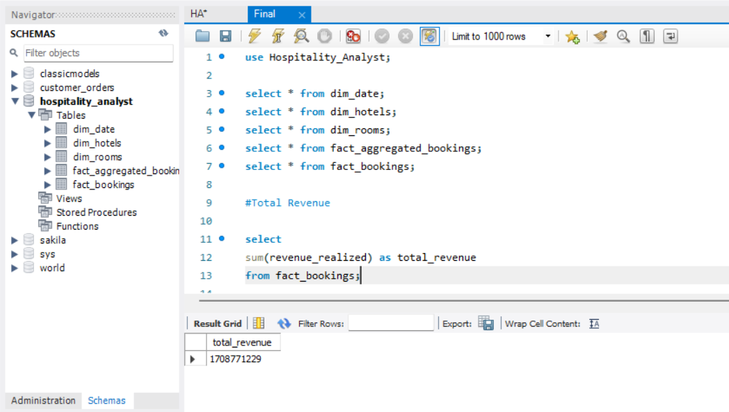

Slide 12
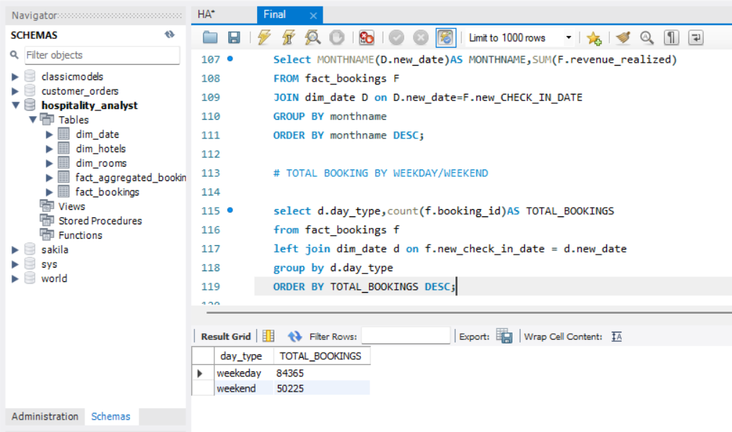

Slide 13
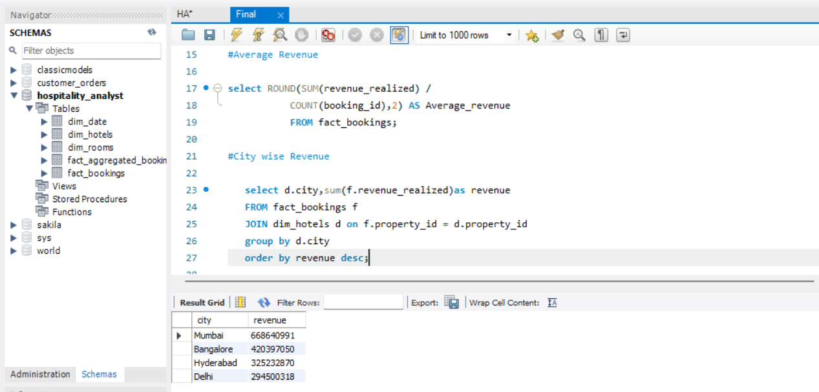

Slide 14
CONCLUSION
The hospitality industry continues to show strong growth driven by rising travel demand, digital booking adoption, and experience-focused consumers. Cost management and workforce retention are key challenges affecting profitability and service consistency.
Businesses that combine operational efficiency with exceptional guest experience are best positioned for future growth. Service quality, personalization, and customer satisfaction remain the most critical competitive factors. Sustainability and responsible tourism are becoming essential for brand reputation and long-term success.

Slide 15
THANK YOU

